Slide 1

Progetto Di Ingegneria Informatica
Aleknovich's Cryptosystem
Mattia Campana

Slide 2



Project Overview
Importance of data protection
With the rise of quantum computing, traditional cryptographic method are at risk, necessitating the development of quantum-resistant cryptosystem.
Project Focus
Exploring alekhnovich's cryptosystem, whic is based on the hardness of decoding linear codes, as a viable post quantum solution.
Target
Assert the theoretical foundations, implementation, and security of the cryptosystem.

Slide 3


The Algorithm
Keys Generation
Gereration of random matrices S (private key) and A, followed by the computation of the public key Y.
Encryption Process
The encryption involves generating a random vectore and combining it with the message and public key.
Decryption Process
Decryption leverages the private key and erro-correcting code to recover the original message from the cyphertext.

Slide 4
Main
Entry point for the whole project:
test 0 to ensure that generate and store all data correctly.
test 1 to measure the efficiency of the error correcting algorithm.

Slide 5
Transpose
Like many other functions I had to implement, this one also operates on a matrix based on individual bits.

Slide 6
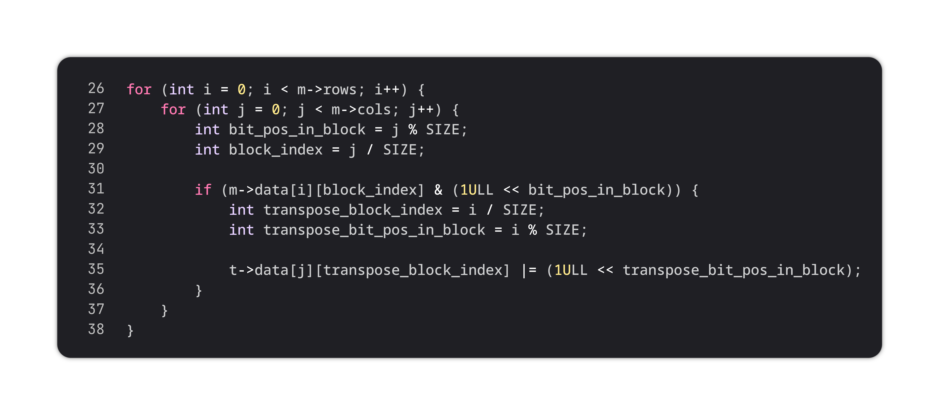
Transpose
For loops used for correct bit arrangement

Slide 7
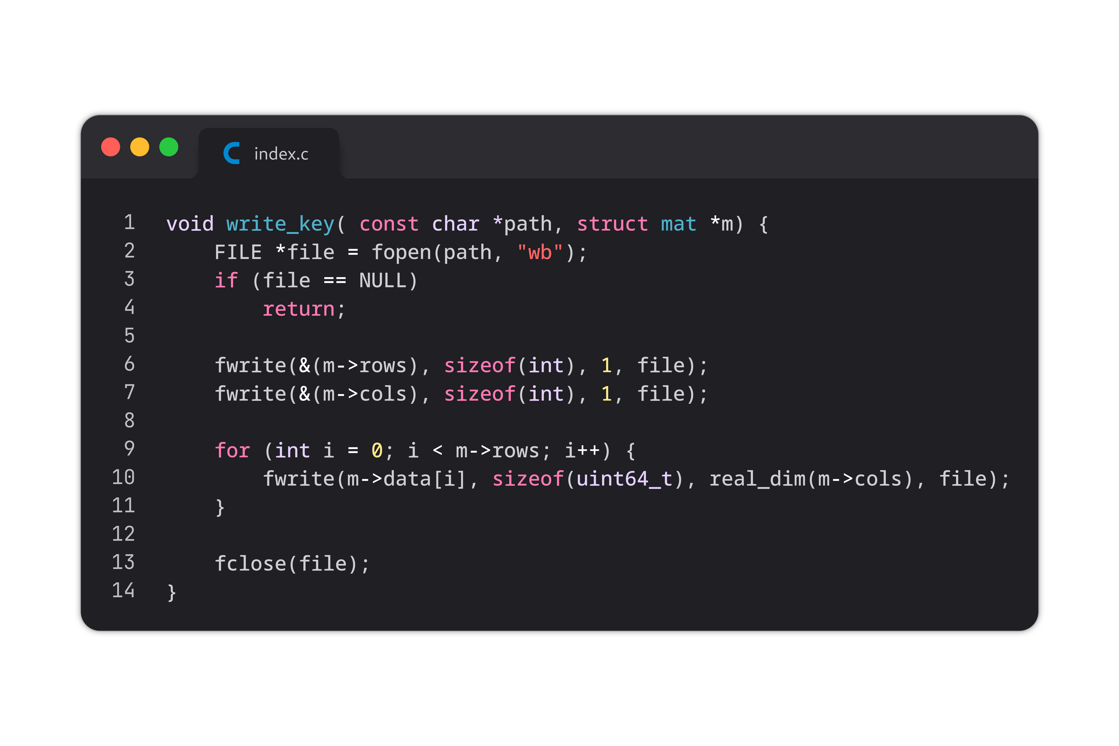
Write Key
Function used to save the public and private keys.
In the same way work the write_packet where it saves elements like the encrypted or decrypted messages.

Slide 8
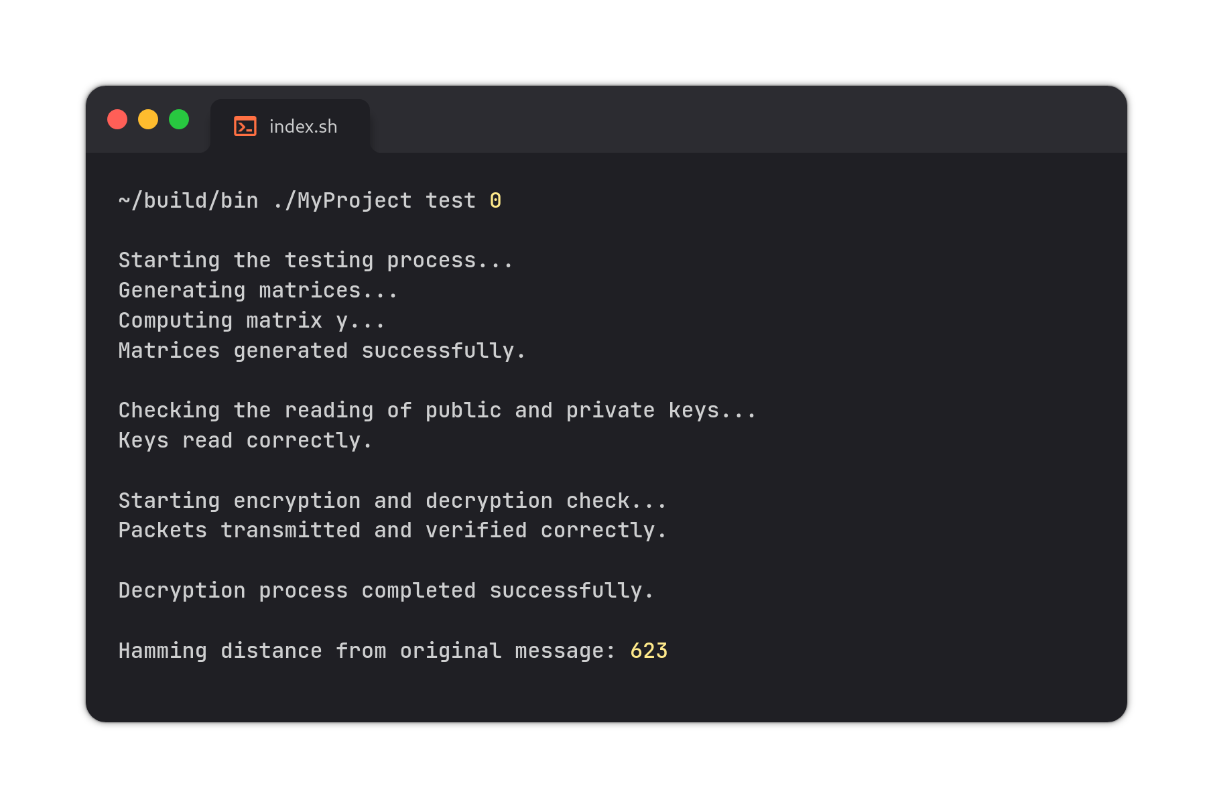
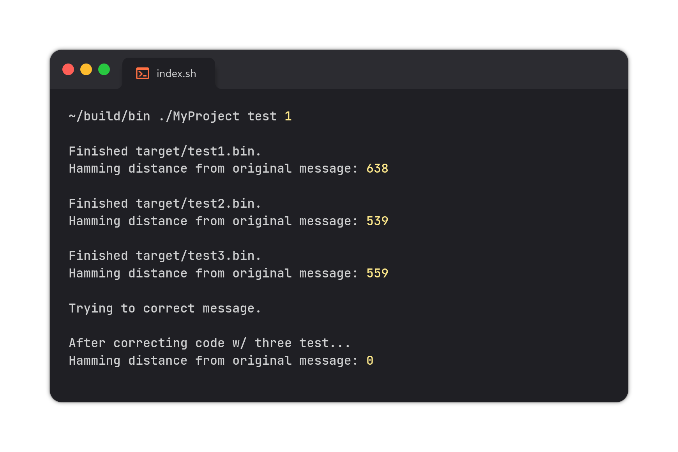
Output Generated
These are examples of the possible result after running the test command.
Keep in mind that by using random vectors to introduce noise, the values are not deterministic.

Slide 9



Future Developments
Post-Quantum Cyptography
Continued research into quantum resistant algorithms is crucial to protect against future quantum threats.
Quantum Computing
Despite the non-imminence of quantum computers for private use, the technology is improving every year.
Standardization Effort
It will require a collective effort to implement new algorithms promptly, thereby minimizing this threat.

Slide 10

End

